Slide 1
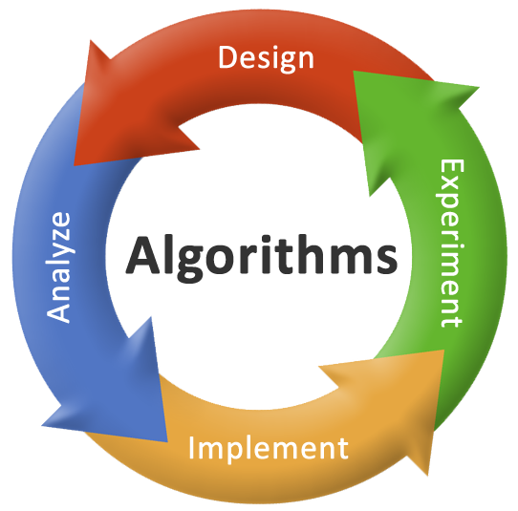
Analysis & Design of Algorithms
Longest Common Subsequence Problem
Prepared by:-
Sagar Virani
Assistant Professor
Computer Engineering Department
VVP Engineering College

Slide 2
Longest Common Subsequence
Biological applications often need to compare the DNA of two or more different organisms.
DNA consists of bases: Adenine, Guanine, Cytosine and Thymine: {A, C, G, T}.
One reason to compare DNA is to determine how “similar” the two strands are, as some measure of how closely related the two organisms are.
Similarity:
One is a substring of another.
Number of changes required to turn one into the other.
Longest common subsequence.

Slide 3
Longest Common Subsequence
Subsequence: Subsequence of a given sequence is just the given sequence with zero or more elements left out. For a given sequence X = <x₁, x₂, x₃, … ,x_{m}>, another sequence Z = <z₁, z₂, z₃, … ,z_{k}> is a subsequence of X if there exists a strictly increasing sequence <i₁, i₂, i₃, … ,i_{k}> of indices of X such that for all j = 1, 2, 3, … ,k, we have x_{ij} = z_{j}.
For example,
X = < A, B, C, B, D, A, B>
Z = < B, C, D, B> with corresponding index sequence < 2, 3, 5, 7>.
Given two sequences X and Y, we say that a sequence Z is a common subsequence of X and Y if Z is a subsequence of both X and Y.
For example,
X = < A, B, C, B, D, A, B> and Y = < B, D, C, A, B, A>
Z = < B, C, A > is a common subsequence.
Z = < B, C, B, A > or < B, D, A, B > is the longest common subsequence.

Slide 4
Longest Common Subsequence
Longest Common Subsequence: Given two sequences X and Y, the sequence Z of maximum length that appear in each of X and Y in same order but no necessarily consecutively.
Brute force method:
Enumerate all subsequences of X and check each subsequence to see whether it is also a subsequence of Y, keeping track of the longest common subsequence we find.
X = <x₁, x₂, x₃, … ,x_{m}>, has 2^{m} subsequences.
This approach takes exponential time, making it impractical for long sequences.

Slide 5
Longest Common Subsequence
Longest Common Subsequence (LCS) has an optimal-substructure property:
If x_{m} = y_{n}, then z_{k} = x_{m} = y_{n} and Z_{k – 1} is an LCS of X_{m – 1} and Y_{n – 1}.
For example,
X = < ……………………......, B, ….. > and Y = < …………….….., B, …. >
Z = < ………., B, ….. >
m
n
k

Slide 6
Longest Common Subsequence
Longest Common Subsequence (LCS) has an optimal-substructure property:
If x_{m} ≠ y_{n}, then z_{k} ≠ x_{m} implies that Z is an LCS of X_{m – 1} and Y.
For example,
X = < ……………………......, B, ….. > and Y = < …………….….., A, …. >
Z = < ………., X, ….. >
m
n
k

Slide 7
Longest Common Subsequence
Longest Common Subsequence (LCS) has an optimal-substructure property:
If x_{m} ≠ y_{n}, then z_{k} ≠ y_{n} implies that Z is an LCS of X and Y_{n – 1}.
For example,
X = < ……………………......, B, ….. > and Y = < …………….….., A, …. >
Z = < ………., X, ….. >
m
n
k

Slide 8
Longest Common Subsequence
Longest Common Subsequence (LCS) has an optimal-substructure property:
If x_{m} = y_{n}, then z_{k} = x_{m} = y_{n} and Z_{k – 1} is an LCS of X_{m – 1} and Y_{n – 1}.
If x_{m} ≠ y_{n}, then z_{k} ≠ x_{m} implies that Z is an LCS of X_{m – 1} and Y.
If x_{m} ≠ y_{n}, then z_{k} ≠ y_{n} implies Z is an LCS of X and Y_{n – 1}.
We should examine either one or two subproblems when finding the LCS of X = <x₁, x₂, x₃, … ,x_{m}>, and Y = <y₁, y₂, y₃, …, y_{n}>.
If x_{m} = y_{n}, we must find and LCS of X_{m – 1} and Y_{n – 1}. Appending x_{m} = y_{n} to this LCS yields an LCS of X and Y.
If x_{m} ≠ y_{n}, then we must solve two subproblems: finding an LCS of X_{m – 1} and Y and finding an LCS of X and Y_{n – 1}. Whichever of these two LCS is longer is an LCS of X and Y.

Slide 9

Longest Common Subsequence
Let c[i, j] to be the length of an LCS of the sequences X_{i} and Y_{j}.
If either i = 0 or j = 0, one of the sequences has length 0, and so the LCS has length 0.
The optimal sub-structure of the LCS problem gives the recursive formula
$$c\left(ⅈ,j\right)=\left\{\begin{matrix}0 \\ 1+c\left[i −1, j −1\right] \\ max⁡(c\left[i −1, j\right], c\left[i, j −1\right]) \end{matrix}\right.$$
If i = 0 or j = 0
If i, j > 0 and x_{i} = y_{j}.
If i, j > 0 and x_{i} ≠ y_{j}.

Slide 10
Longest Common Subsequence
Example:
X = < A, B, C, B, D, A, B > and Y = < B, D, C, A, B, A >
B
D
C
A
B
A
0
0
0
0
0
0
A
0
B
0
C
0
B
0
D
0
A
0
B
0

Slide 11
Longest Common Subsequence
Example:
X = < A, B, C, B, D, A, B > and Y = < B, D, C, A, B, A >
B
D
C
A
B
A
0
0
0
0
0
0
A
0
0
B
0
C
0
B
0
D
0
A
0
B
0

Slide 12
Longest Common Subsequence
Example:
X = < A, B, C, B, D, A, B > and Y = < B, D, C, A, B, A >
B
D
C
A
B
A
0
0
0
0
0
0
A
0
0
0
B
0
C
0
B
0
D
0
A
0
B
0

Slide 13
Longest Common Subsequence
Example:
X = < A, B, C, B, D, A, B > and Y = < B, D, C, A, B, A >
B
D
C
A
B
A
0
0
0
0
0
0
A
0
0
0
0
B
0
C
0
B
0
D
0
A
0
B
0

Slide 14
Longest Common Subsequence
Example:
X = < A, B, C, B, D, A, B > and Y = < B, D, C, A, B, A >
B
D
C
A
B
A
0
0
0
0
0
0
A
0
0
0
1
0
B
0
C
0
B
0
D
0
A
0
B
0

Slide 15
Longest Common Subsequence
Example:
X = < A, B, C, B, D, A, B > and Y = < B, D, C, A, B, A >
B
D
C
A
B
A
0
0
0
0
0
0
A
0
0
0
1
1
0
B
0
C
0
B
0
D
0
A
0
B
0

Slide 16
Longest Common Subsequence
Example:
X = < A, B, C, B, D, A, B > and Y = < B, D, C, A, B, A >
B
D
C
A
B
A
0
0
0
0
0
0
A
0
0
0
1
1
1
0
B
0
C
0
B
0
D
0
A
0
B
0

Slide 17
Longest Common Subsequence
Example:
X = < A, B, C, B, D, A, B > and Y = < B, D, C, A, B, A >
B
D
C
A
B
A
0
0
0
0
0
0
A
0
0
0
1
1
1
0
B
1
0
C
0
B
0
D
0
A
0
B
0

Slide 18
Longest Common Subsequence
Example:
X = < A, B, C, B, D, A, B > and Y = < B, D, C, A, B, A >
B
D
C
A
B
A
0
0
0
0
0
0
A
0
0
0
1
1
1
0
B
1
1
0
C
0
B
0
D
0
A
0
B
0

Slide 19
Longest Common Subsequence
Example:
X = < A, B, C, B, D, A, B > and Y = < B, D, C, A, B, A >
B
D
C
A
B
A
0
0
0
0
0
0
A
0
0
0
1
1
1
0
B
1
1
1
0
C
0
B
0
D
0
A
0
B
0

Slide 20
Longest Common Subsequence
Example:
X = < A, B, C, B, D, A, B > and Y = < B, D, C, A, B, A >
B
D
C
A
B
A
0
0
0
0
0
0
A
0
0
0
1
1
1
0
B
1
1
1
1
0
C
0
B
0
D
0
A
0
B
0

Slide 21
Longest Common Subsequence
Example:
X = < A, B, C, B, D, A, B > and Y = < B, D, C, A, B, A >
B
D
C
A
B
A
0
0
0
0
0
0
A
0
0
0
1
1
1
0
B
1
1
1
1
2
0
C
0
B
0
D
0
A
0
B
0

Slide 22
Longest Common Subsequence
Example:
X = < A, B, C, B, D, A, B > and Y = < B, D, C, A, B, A >
B
D
C
A
B
A
0
0
0
0
0
0
A
0
0
0
1
1
1
0
B
1
1
1
1
2
2
0
C
0
B
0
D
0
A
0
B
0

Slide 23
Longest Common Subsequence
Example:
X = < A, B, C, B, D, A, B > and Y = < B, D, C, A, B, A >
B
D
C
A
B
A
0
0
0
0
0
0
A
0
0
0
1
1
1
0
B
1
1
1
1
2
2
0
C
1
0
B
0
D
0
A
0
B
0

Slide 24
Longest Common Subsequence
Example:
X = < A, B, C, B, D, A, B > and Y = < B, D, C, A, B, A >
B
D
C
A
B
A
0
0
0
0
0
0
A
0
0
0
1
1
1
0
B
1
1
1
1
2
2
0
C
1
1
0
B
0
D
0
A
0
B
0

Slide 25
Longest Common Subsequence
Example:
X = < A, B, C, B, D, A, B > and Y = < B, D, C, A, B, A >
B
D
C
A
B
A
0
0
0
0
0
0
A
0
0
0
1
1
1
0
B
1
1
1
1
2
2
0
C
1
1
2
0
B
0
D
0
A
0
B
0

Slide 26
Longest Common Subsequence
Example:
X = < A, B, C, B, D, A, B > and Y = < B, D, C, A, B, A >
B
D
C
A
B
A
0
0
0
0
0
0
A
0
0
0
1
1
1
0
B
1
1
1
1
2
2
0
C
1
1
2
2
0
B
0
D
0
A
0
B
0

Slide 27
Longest Common Subsequence
Example:
X = < A, B, C, B, D, A, B > and Y = < B, D, C, A, B, A >
B
D
C
A
B
A
0
0
0
0
0
0
A
0
0
0
1
1
1
0
B
1
1
1
1
2
2
0
C
1
1
2
2
2
0
B
0
D
0
A
0
B
0

Slide 28
Longest Common Subsequence
Example:
X = < A, B, C, B, D, A, B > and Y = < B, D, C, A, B, A >
B
D
C
A
B
A
0
0
0
0
0
0
A
0
0
0
1
1
1
0
B
1
1
1
1
2
2
0
C
1
1
2
2
2
2
0
B
0
D
0
A
0
B
0

Slide 29
Longest Common Subsequence
Example:
X = < A, B, C, B, D, A, B > and Y = < B, D, C, A, B, A >
B
D
C
A
B
A
0
0
0
0
0
0
A
0
0
0
1
1
1
0
B
1
1
1
1
2
2
0
C
1
1
2
2
2
2
0
B
0
1
D
0
A
0
B
0

Slide 30
Longest Common Subsequence
Example:
X = < A, B, C, B, D, A, B > and Y = < B, D, C, A, B, A >
B
D
C
A
B
A
0
0
0
0
0
0
A
0
0
0
1
1
1
0
B
1
1
1
1
2
2
0
C
1
1
2
2
2
2
0
B
0
1
1
D
0
A
0
B
0

Slide 31
Longest Common Subsequence
Example:
X = < A, B, C, B, D, A, B > and Y = < B, D, C, A, B, A >
B
D
C
A
B
A
0
0
0
0
0
0
A
0
0
0
1
1
1
0
B
1
1
1
1
2
2
0
C
1
1
2
2
2
2
0
B
0
1
1
2
D
0
A
0
B
0

Slide 32
Longest Common Subsequence
Example:
X = < A, B, C, B, D, A, B > and Y = < B, D, C, A, B, A >
B
D
C
A
B
A
0
0
0
0
0
0
A
0
0
0
1
1
1
0
B
1
1
1
1
2
2
0
C
1
1
2
2
2
2
0
B
2
0
1
1
2
D
0
A
0
B
0

Slide 33
Longest Common Subsequence
Example:
X = < A, B, C, B, D, A, B > and Y = < B, D, C, A, B, A >
B
D
C
A
B
A
0
0
0
0
0
0
A
0
0
0
1
1
1
0
B
1
1
1
1
2
2
0
C
1
1
2
2
2
2
0
B
2
3
0
1
1
2
D
0
A
0
B
0

Slide 34
Longest Common Subsequence
Example:
X = < A, B, C, B, D, A, B > and Y = < B, D, C, A, B, A >
B
D
C
A
B
A
0
0
0
0
0
0
A
0
0
0
1
1
1
0
B
1
1
1
1
2
2
0
C
1
1
2
2
2
2
0
B
2
3
3
0
1
1
2
D
0
A
0
B
0

Slide 35
Longest Common Subsequence
Example:
X = < A, B, C, B, D, A, B > and Y = < B, D, C, A, B, A >
B
D
C
A
B
A
0
0
0
0
0
0
A
0
0
0
1
1
1
0
B
1
1
1
1
2
2
0
C
1
1
2
2
2
2
0
B
2
3
3
0
1
1
2
D
2
3
3
0
1
2
2
A
0
B
0

Slide 36
Longest Common Subsequence
Example:
X = < A, B, C, B, D, A, B > and Y = < B, D, C, A, B, A >
B
D
C
A
B
A
0
0
0
0
0
0
A
0
0
0
1
1
1
0
B
1
1
1
1
2
2
0
C
1
1
2
2
2
2
0
B
2
3
3
0
1
1
2
D
2
3
3
0
1
2
2
A
1
2
2
3
3
4
0
B
0

Slide 37
Longest Common Subsequence
Example:
X = < A, B, C, B, D, A, B > and Y = < B, D, C, A, B, A >
B
D
C
A
B
A
0
0
0
0
0
0
A
0
0
0
1
1
1
0
B
1
1
1
1
2
2
0
C
1
1
2
2
2
2
0
B
2
3
3
0
1
1
2
D
2
3
3
0
1
2
2
A
1
2
2
3
3
4
0
B
3
4
4
Length of the LCS = 4
0
1
2
2

Slide 38
Longest Common Subsequence
Example:
X = < A, B, C, B, D, A, B > and Y = < B, D, C, A, B, A >
B
D
C
A
B
A
0
0
0
0
0
0
A
0
0
0
1
1
1
0
B
1
1
1
1
2
2
0
C
1
1
2
2
2
2
0
B
2
3
3
0
1
1
2
D
2
3
3
0
1
2
2
A
1
2
2
3
3
4
0
B
3
4
4
0
1
2
2

Slide 39
Longest Common Subsequence
Example:
X = < A, B, C, B, D, A, B > and Y = < B, D, C, A, B, A >
B
D
C
A
B
A
0
0
0
0
0
0
A
0
0
0
1
1
1
0
B
1
1
1
1
2
2
0
C
1
1
2
2
2
2
0
B
2
3
3
0
1
1
2
D
2
3
3
0
1
2
2
A
1
2
2
3
3
4
0
B
3
4
4
0
1
2
2

Slide 40
Longest Common Subsequence
Example:
X = < A, B, C, B, D, A, B > and Y = < B, D, C, A, B, A >
B
D
C
A
B
A
0
0
0
0
0
0
A
0
0
0
1
1
1
0
B
1
1
1
1
2
2
0
C
1
1
2
2
2
2
0
B
2
3
3
0
1
1
2
D
2
3
3
0
1
2
2
A
1
2
2
3
3
4
0
B
3
4
4
0
1
2
2

Slide 41
Longest Common Subsequence
Example:
X = < A, B, C, B, D, A, B > and Y = < B, D, C, A, B, A >
B
D
C
A
B
A
0
0
0
0
0
0
A
0
0
0
1
1
1
0
B
1
1
1
1
2
2
0
C
1
1
2
2
2
2
0
B
2
3
3
0
1
1
2
D
2
3
3
0
1
2
2
A
1
2
2
3
3
4
0
B
3
4
4
0
1
2
2

Slide 42
Longest Common Subsequence
Example:
X = < A, B, C, B, D, A, B > and Y = < B, D, C, A, B, A >
B
D
C
A
B
A
0
0
0
0
0
0
A
0
0
0
1
1
1
0
B
1
1
1
1
2
2
0
C
1
1
2
2
2
2
0
B
2
3
3
0
1
1
2
D
2
3
3
0
1
2
2
A
1
2
2
3
3
4
0
B
3
4
4
0
1
2
2

Slide 43
Longest Common Subsequence
Example:
X = < A, B, C, B, D, A, B > and Y = < B, D, C, A, B, A >
B
D
C
A
B
A
0
0
0
0
0
0
A
0
0
0
1
1
1
0
B
1
1
1
1
2
2
0
C
1
1
2
2
2
2
0
B
2
3
3
0
1
1
2
D
2
3
3
0
1
2
2
A
1
2
2
3
3
4
0
B
3
4
4
0
1
2
2

Slide 44
Longest Common Subsequence
Example:
X = < A, B, C, B, D, A, B > and Y = < B, D, C, A, B, A >
B
D
C
A
B
A
0
0
0
0
0
0
A
0
0
0
1
1
1
0
B
1
1
1
1
2
2
0
C
1
1
2
2
2
2
0
B
2
3
3
0
1
1
2
D
2
3
3
0
1
2
2
A
1
2
2
3
3
4
0
B
3
4
4
0
1
2
2

Slide 45
Longest Common Subsequence
Example:
X = < A, B, C, B, D, A, B > and Y = < B, D, C, A, B, A >
B
D
C
A
B
A
0
0
0
0
0
0
A
0
0
0
1
1
1
0
B
1
1
1
1
2
2
0
C
1
1
2
2
2
2
0
B
2
3
3
0
1
1
2
D
2
3
3
0
1
2
2
A
1
2
2
3
3
4
0
B
3
4
4
0
1
2
2

Slide 46
Longest Common Subsequence
Example:
X = < A, B, C, B, D, A, B > and Y = < B, D, C, A, B, A >
B
D
C
A
B
A
0
0
0
0
0
0
A
0
0
0
1
1
1
0
B
1
1
1
1
2
2
0
C
1
1
2
2
2
2
0
B
2
3
3
0
1
1
2
D
2
3
3
0
1
2
2
A
1
2
2
3
3
4
0
B
3
4
4
LCS = < B, C, B, A >
0
1
2
2

Slide 47
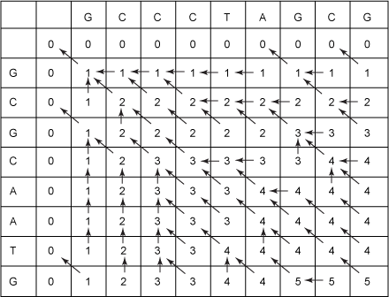
Longest Common Subsequence
Do it yourself:
S1 = <G, C, C, C, T, A, G, C, G> and S2 = <G, C, G, C, A, A, T, G>.

Slide 48
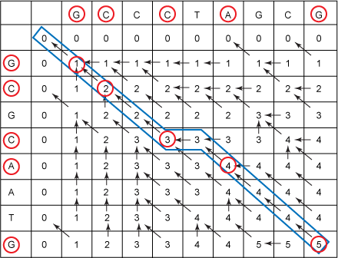
Longest Common Subsequence
Do it yourself:
S1 = < G, C, C, C, T, A, G, C, G > and S2 = < G, C, G, C, A, A, T, G >.

Slide 49
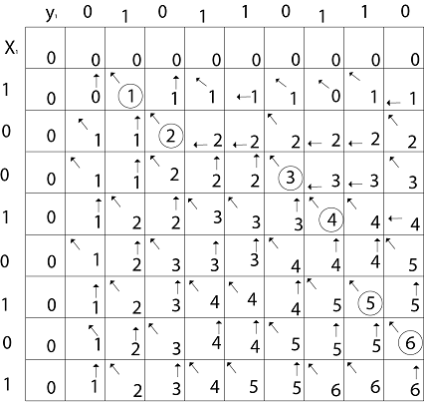
Longest Common Subsequence
Do it yourself:
X = <1, 0, 0, 1, 0, 1, 0, 1 > and Y = <0, 1, 0, 1, 1, 0, 1, 1, 0 >.

Slide 50
Longest Common Subsequence
Algorithm: LCS-LENGTH(X, Y)
m = X.length and n = Y.length
let b[ 1 … m, 1 … n ] & c[ 0 … m, 0 … n ] be new tables
for i = 0 to m do c[ i, 0 ] = 0
for j = 0 to n do c[ 0, j ] = 0
for i = 1 to m
for j = 1 to n
if x_{i} == y_{j}.
c[ i, j ] = 1 + c[ i – 1, j – 1 ]
b[ i, j ] = “ ”
else if c[ i - 1, j ] ≥ c[ i, j – 1 ]
c[ i, j ] = c[ i – 1, j ]
b[ i, j ] = “ ”
else
c[ i, j ] = c[ i, j – 1 ]
b[ i, j ] = “ ”
return c and b

Slide 51
Longest Common Subsequence
Algorithm: LCS-LENGTH(X, Y)
m = X.length and n = Y.length
let b[ 1 … m, 1 … n ] & c[ 0 … m, 0 … n ] be new tables
for i = 0 to m do c[ i, 0 ] = 0
for j = 0 to n do c[ 0, j ] = 0
for i = 1 to m
for j = 1 to n
if x_{i} == y_{j}.
c[ i, j ] = 1 + c[ i – 1, j – 1 ]
b[ i, j ] = “ ”
else if c[ i - 1, j ] ≥ c[ i, j – 1 ]
c[ i, j ] = c[ i – 1, j ]
b[ i, j ] = “ ”
else
c[ i, j ] = c[ i, j – 1 ]
b[ i, j ] = “ ”
return c and b
Analysis:
Initialization takes Ө(m + n).

Slide 52
Longest Common Subsequence
Algorithm: LCS-LENGTH(X, Y)
m = X.length and n = Y.length
let b[ 1 … m, 1 … n ] & c[ 0 … m, 0 … n ] be new tables
for i = 0 to m do c[ i, 0 ] = 0
for j = 0 to n do c[ 0, j ] = 0
for i = 1 to m
for j = 1 to n
if x_{i} == y_{j}.
c[ i, j ] = 1 + c[ i – 1, j – 1 ]
b[ i, j ] = “ ”
else if c[ i - 1, j ] ≥ c[ i, j – 1 ]
c[ i, j ] = c[ i – 1, j ]
b[ i, j ] = “ ”
else
c[ i, j ] = c[ i, j – 1 ]
b[ i, j ] = “ ”
return c and b
Analysis:
Initialization takes Ө(m + n).
The loops are nested two level deep, the outer loop is executed m times and inner loop is executed n times.
Therefore, the running time of the algorithm is Ө(mn).

Slide 53
Any Questions?

